Slide 1
Movie Database Analysis
Isaac Muturi
11-Mar-2023

Slide 2
Overview
Business Understanding
Data Understanding
Data Analysis
Recommendations
Next Steps
Thank You
prompt for questions as well as your contact information (name and LinkedIn profile)

Slide 3
Business Understanding
The movie industry is complex and involves various stakeholders. Success depends on several factors, including script quality, star power, marketing, release date, and competition.
To analyze the industry, we need data from multiple sources and use data science techniques. A combination of quantitative and qualitative analysis techniques and domain expertise is necessary to make informed decisions for producing successful movies and improving the industry's profitability.

Slide 4
Data Understanding
The First Dataset
Name: tn.movie_budgets.csv
Type: csv
Time frame of the data: 1915 to 2020
Total data points : 5782 records
Data columns (total 6 columns):
# Column Dtype
--- ------ -----
0 id int64
1 release_date object
2 movie object
3 production_budget object
4 domestic_gross object
5 worldwide_gross object
dtypes: int64(1), object(5)

Slide 5
The second dataset
Data Understanding
Name: im.db
Type: sqlite database
Table Names columns
0 movie_basics (movie_id, primary_title, original_title, start_year, runtime_minutes, genres)
1 directors (movie_id, person_id)
2 known_for (person_id, movie_id)
3 movie_akas (movie_id, ordering, title, region, language, types, attributes, is_original_title)
4 movie_ratings (movie_id, averagerating, numvotes)
5 persons (person_id, primary_name, birth_year, death_year, primary_profession)
6 principals (movie_id, ordering, person_id, category, job, characters)
7 writers (movie_id, person_id)

Slide 6
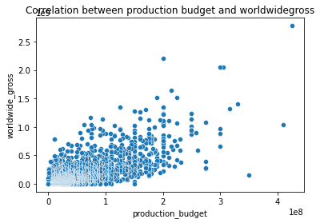
Data Analysis what is the relationship between production budget and worldwide gross
There is a positive relationship between production budget and worldwide gross

Slide 7
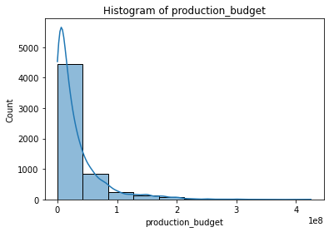
What is the distribution of production budget
The number of movies increases as the production budget increases.

Slide 8
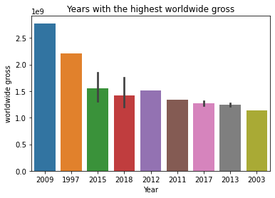
Which are the highest grossing years
There is no correlation between year of movie release and worldwide gross.

Slide 9
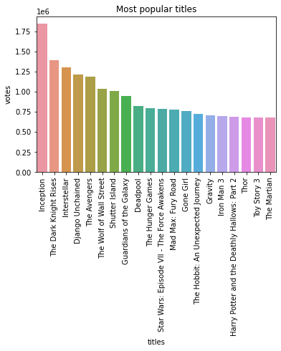
Which are the most popular titles
Movie sequels are very popular. They make a majority in this list

Slide 10
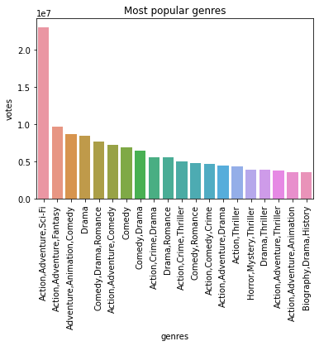
which are the most popular genres
A combo of Action, Adventure and Sci-Fi are significantly more popular than other genres

Slide 11
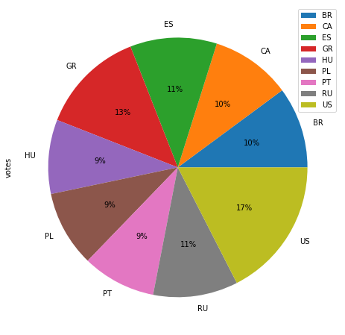
Which are the most popular regions or markets
US is the clear leader with 17 % of the market among the top 10 regions, followed by GR with 13% and then a tie at 10% by CA and BR

Slide 12
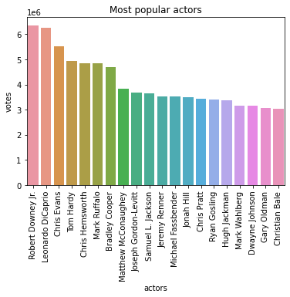
Who are the most popular actors
Robert Downey Jr leads the pack, followed closely by Leonardo DiCaprio, then Chris Evans and other popular movie actors

Slide 13
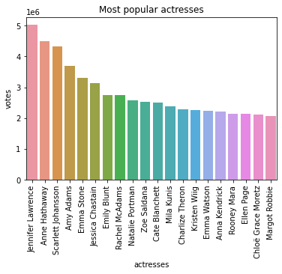
Who are the most popular actresses
Jennifer Lawrence leads the pack, followed by Anne Hathaway and Scarlett Johansson and other popular actresses

Slide 14
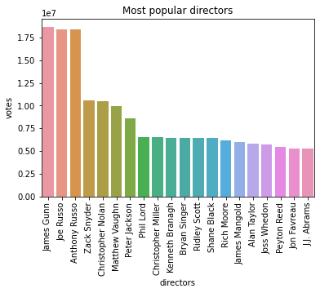
Who are the most popular directors
Three directors, James Gunn, Joe Russo and Anthony Russo lead significantly followed by other popular directors

Slide 15
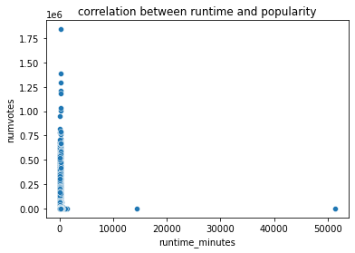
What is the correlation between movie runtime and popularity
There is no correlation between runtime and popularity of movies

Slide 16
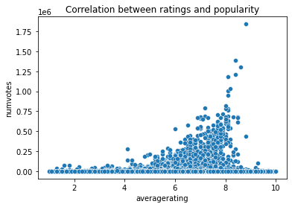
What is the correlation between movie ratings and popularity?
There is a positive relationship between movie ratings and popularity.

Slide 17
Recommendations
Collaborate with Popular Actors and Directors: Actors and directors who have a strong track record of success can be highly valuable to movie production companies.
Create Content Based on Audience Interests: By analyzing the data on ratings, it is possible to identify the genres and storylines that are most popular among audiences. A combo of Action, Adventure and Sci-Fi are significantly more popular than other genres.
It is important to consider this audience preferences which differ based on region when planning movie production and distribution. US is the clear leader with 17 % of the market among the top 10 regions, followed by GR with 13% and then a tie at 10% by CA and BR. You can decide to focus your content to cater for these more potent markets.

Slide 18
What are the next steps
Overall, the next steps for the movie dataset analysis project involve a combination of data cleaning, exploratory analysis, feature engineering, model selection, evaluation, and deployment. By following a structured approach and leveraging the latest tools and techniques, data scientists can generate valuable insights that can inform decision-making in the movie industry.

Slide 19
Thank You
This presentation is prepared by Isaac Muturi.
If you have any enquiry, feel free to contact me at:
https://www.linkedin.com/in/ndirangu-muturi-3b6b2b237

